Slide 1
Introduction to Software Testing
Chapter 7.1
Engineering Criteria for Technologies
Paul Ammann & Jeff Offutt
http://www.cs.gmu.edu/~offutt/softwaretest/

Slide 2
The Technologies
Chapters 1-5 emphasize criteria on four models of software
Emphasis in each chapter was first on the criteria, then on how to construct the models from different software artifacts
This chapter discusses how to apply the criteria to specific technologies
  Most of the ideas in this chapter were developed after the year 2000
  Thus they are still evolving
Introduction to Software Testing (Ch 7)
© Ammann and Offutt

Slide 3
Chapter 7 Outline
Object-Oriented Software
Object-Oriented Software
Web Applications and Web Services
Graphical User Interfaces
Real-Time and Embedded Software
Introduction to Software Testing (Ch 7)
© Ammann and Offutt

Slide 4
Section 7.1 Outline
Overview
Overview
Types of Object-Oriented Faults
  Example
  The Yo-Yo Graph and Polymorphism
  Categories of Inheritance Faults
  Testing Inheritance, Polymorphism and Dynamic Binding
  Object-Oriented Testing Criteria
Introduction to Software Testing (Ch 7)
© Ammann and Offutt

Slide 5
Inheritance
Allows common features of many classes to be defined in one class
A derived class has everything its parent has, plus it can:
Enhance derived features (overriding)
Restrict derived features
Add new features (extension)
Introduction to Software Testing (Ch 7)
© Ammann and Offutt
Notes:
The power of inheritance is its ability to utilize an existing object class and easily create a similar class with either more or less functionality without significant reimplementation.

Slide 6
Inheritance (2)
Declared type:
The type given when an object reference is declared
Clock w1; // declared type Clock
Actual type:
The type of the current object
w1 = new Watch(); // actual type Watch
A
In Java, the method that is executed is the lowest version of the method defined between the actual and declared types in the inheritance hierarchy
B
C
Introduction to Software Testing (Ch 7)
© Ammann and Offutt

Slide 7
Access Control (in Java)
Class 1
Package
public members
protected members
Class 3
default
private members
inheritance
Class 2
Class 5
Class 4
Introduction to Software Testing (Ch 7)
© Ammann and Offutt

Slide 8
Polymorphism
The same variable can have different types depending on the program execution
If B inherits from A, then an object of type B can be used when an object of type A is expected
If both A and B define the same method M (B overrides A), then the same statement might call either A’s version of M or B’s version
Introduction to Software Testing (Ch 7)
© Ammann and Offutt

Slide 9
Subtype and Subclass Inheritance
Subtype Inheritance : If B inherits from A, any object of type B can be substituted for an object of type A
  A laptop “is a” special type of computer
  Called substitutability
animal
human
deer
Subclass Inheritance : Objects of type B may not be substituted for objects of type A
  Objects of B may not be “type compatible”
  In Java’s collection framework, a Stack inherits from a Vector … convenient for implementation, but a stack is definitely not a vector
human
This gives a deer access to “hands” !
deer
Introduction to Software Testing (Ch 7)
© Ammann and Offutt

Slide 10
Testing OO Software
Intra-method testing : Testing individual methods within classes
Inter-method testing : Multiple methods within a class are tested in concert
Intra-class testing : Testing a single class, usually using sequences of calls to methods within the class
Inter-class testing : More than one class is tested at the same time (integration)
Introduction to Software Testing (Ch 7)
© Ammann and Offutt

Slide 11
Section 7.1 Outline
Overview
Types of Object-Oriented Faults
  Example
  The Yo-Yo Graph and Polymorphism
  Categories of Inheritance Faults
  Testing Inheritance, Polymorphism and Dynamic Binding
  Object-Oriented Testing Criteria
Example
Introduction to Software Testing (Ch 7)
© Ammann and Offutt

Slide 12
Example DU Pairs and Anomalies
Consider what happens when an overriding method has a different def-set than the overridden method
A
def-use
-u
-v
-w
+h()
+i()
+j()
+l()
Method
Defs
Uses
A::h ()
{A::u, A::w}
A::i ()
{A::u}
A::j ()
{A::v}
{A::w}
B
A::l()
{A::v}
DU
anomaly
-x
+h ()
+i ()
B::h()
{B::x}
B::i()
{B::x}
C::i()
C
C::j()
{C::y}
{C::y}
-y
+i ()
+j ()
A::h() calls j(), B::h() does not
def-use
DU
anomaly
Introduction to Software Testing (Ch 7)
© Ammann and Offutt

Slide 13
Section 7.1 Outline
Overview
Types of Object-Oriented Faults
  Example
  The Yo-Yo Graph and Polymorphism
  Categories of Inheritance Faults
  Testing Inheritance, Polymorphism and Dynamic Binding
  Object-Oriented Testing Criteria
The Yo-Yo Graph and Polymorphism
Introduction to Software Testing (Ch 7)
© Ammann and Offutt

Slide 14
Polymorphism Headaches (Yo-Yo)
A
Actual
type
+d ()
+g ()
+h ()
+i ()
+j ()
+l ()
A
d()
g()
h()
i()
j()
l()
B
h()
i()
k()
C
i()
j()
l()
Object is of actual type A
A::d ()
d() calls g(), which calls h(), which calls i(), which calls j()
Introduction to Software Testing (Ch 7)
© Ammann and Offutt

Slide 15
Polymorphism Headaches (Yo-Yo)
A
+d ()
+g ()
+h ()
+i ()
+j ()
+l ()
A
d()
g()
h()
i()
j()
l()
B
h()
i()
k()
C
i()
j()
l()
A
d()
g()
h()
i()
j()
l()
B
Actual
type
+h ()
+i ()
+k ()
B
h()
i()
k()
C
i()
j()
l()
Object is of actual type B
B::d ()
Introduction to Software Testing (Ch 7)
© Ammann and Offutt

Slide 16
Polymorphism Headaches (Yo-Yo)
A
+d ()
+g ()
+h ()
+i ()
+j ()
+l ()
A
d()
g()
h()
i()
j()
l()
B
h()
i()
k()
C
i()
j()
l()
A
d()
g()
h()
i()
j()
l()
B
+h ()
+i ()
+k ()
B
h()
i()
k()
C
i()
j()
l()
A
d()
g()
h()
i()
j()
l()
B
h()
i()
k()
C
Actual
type
+i ()
+j ()
+l ()
C
i()
j()
l()
Object is of actual type C, C::d ()
Introduction to Software Testing (Ch 7)
© Ammann and Offutt

Slide 17
Section 7.1 Outline
Overview
Types of Object-Oriented Faults
  Example
  The Yo-Yo Graph and Polymorphism
  Categories of Inheritance Faults
  Testing Inheritance, Polymorphism and Dynamic Binding
  Object-Oriented Testing Criteria
Categories of Inheritance Faults
Introduction to Software Testing (Ch 7)
© Ammann and Offutt

Slide 18
Potential for Faults in OO Programs
Complexity is relocated to the connections among components
Less static determinism – many faults can now only be detected at runtime
Inheritance and Polymorphism yield vertical and dynamic integration
Aggregation and use relationships are more complex
Designers do not carefully consider visibility of data and methods
Introduction to Software Testing (Ch 7)
© Ammann and Offutt

Slide 19
Object-oriented Faults
Only consider faults that arise as a direct result of OO language features:
  inheritance
  polymorphism
  constructors
  visibility
Language independent (as much as possible)
Introduction to Software Testing (Ch 7)
© Ammann and Offutt

Slide 20
OO Faults and Anomalies
Acronym | Fault / Anomaly
ITU | Inconsistent Type Use
SDA | State Definition Anomaly
SDIH | State Definition Inconsistency
SDI | State Defined Incorrectly
IISD | Indirect Inconsistent State Definition
ACB1 | Anomalous Construction Behavior (1)
ACB2 | Anomalous Construction Behavior (2)
IC | Incomplete Construction
SVA | State Visibility Anomaly
Examples
shown
Introduction to Software Testing (Ch 7)
© Ammann and Offutt

Slide 21
Inconsistent Type Use (ITU)
No overriding (no polymorphism)
C extends T, and C adds new methods (extension)
An object is used “as a C”, then as a T, then as a C
Methods in T can put object in state that is inconsistent for C
s.push (“Steffi”);
s.push (“Joyce”);
s.push (“Andrew”);
dumb (s);
s.pop();
s.pop();
s.pop();
void dumb (Vector v)
{
v.removeElementAt (v.size()-1);
}
Vector
-array
+insertElementAt()
+removeElementAt()
// Stack is empty!
Stack
call
+pop (): Object
+push (): Object
call
Introduction to Software Testing (Ch 7)
© Ammann and Offutt

Slide 22
State Definition Anomaly (SDA)
X extends W, and X overrides some methods
The overriding methods in X fail to define some variables that the overridden methods in W defined
W
v
u
m()
n()
W::m () defines v and W::n() uses v
X::n () uses v
Y::m () does not define v
For an object of actual type Y, a data flow anomaly exists and results in a fault if m() is called, then n()
X
x
n()
Y
w
m()
Introduction to Software Testing (Ch 7)
© Ammann and Offutt

Slide 23
State Definition Inconsistency (SDIH)
Hiding a variable, possibly accidentally
If the descendant’s version of the variable is defined, the ancestor’s version may not be
W
v
u
m()
n()
Y overrides W’s version of v
Y::m() defines Y::v
X::n() uses v … getting W’s version of v
For an object of actual type Y, a data flow inconsistency may exist and result in a fault if m() is called, then n()
X
x
n()
overrides
(hides)
Y
v
m()
Introduction to Software Testing (Ch 7)
© Ammann and Offutt

Slide 24
Anomalous Construction Behavior (ACB1)
Constructor of W calls a method f()
A child of W, X, overrides f()
X::f() uses variables that should be defined by X’s constructor
W
W()
f()
When an object of type X is constructed, W() is run before X().
When W() calls X::f(), x is used, but has not yet been given a value!
Calls
Overrides
X
x
f()
Uses
Introduction to Software Testing (Ch 7)
© Ammann and Offutt

Slide 25
State Visibility Anomaly (SVA)
A private variable v is declared in ancestor W, and v is defined by W::m()
X extends W and Y extends X
Y overrides m(), and calls W::m() to define v
W
W
-v
m()
-v
m()
Overrides,
calls
Overrides
X
X
X::m() is added later
Y:m() can no longer call W::m()!
m()
Overrides,
calls
Y
Y
m()
m()
Introduction to Software Testing (Ch 7)
© Ammann and Offutt

Slide 26
Section 7.1 Outline
Overview
Types of Object-Oriented Faults
  Example
  The Yo-Yo Graph and Polymorphism
  Categories of Inheritance Faults
  Testing Inheritance, Polymorphism and Dynamic Binding
  Object-Oriented Testing Criteria
Testing Inheritance, Polymorphism and Dynamic Binding
Introduction to Software Testing (Ch 7)
© Ammann and Offutt

Slide 27
Coupling Sequences
Pairs of method calls within body of method under test:
  Made through a common instance context
  With respect to a set of state variables that are commonly referenced by both methods
  Consists of at least one coupling path between the two method calls with respect to a particular state variable
Represent potential state space interactions between the called methods with respect to calling method
Used to identify points of integration and testing requirements
Introduction to Software Testing (Ch 7)
© Ammann and Offutt

Slide 28
Types of Def-Use Pairs
def
def
A ()
last-def
A ()
use
inter-procedural data flow
B () use
first-use
B ()
A ()
intra-procedural data flow
(within the same unit)
full
coupling
def
A()
A()
M ()
A()
M()
def
A()
B()
use
B()
N()
B()
N()
use
B()
F ()
F()
object-oriented direct coupling data flow
object-oriented indirect coupling data flow
Introduction to Software Testing (Ch 7)
© Ammann and Offutt

Slide 29
Coupling-Based Testing (from Ch 2)
Test data and control connections
Derived from previous work for procedural programs
Based on insight that integration occurs through couplings among software artifacts
Caller
F
x = 14
y = G (x)
print (y)
last-def-before-call
call site
first-use-after-call
Callee
G (a)
print (a)
b = 42
return (b)
first-use-in-callee
last-def-before-return
Introduction to Software Testing (Ch 7)
© Ammann and Offutt

Slide 30
Polymorphic Call Set
public void f ( W o )
{
…
j o.m();
…
l o.l();
…
k o.n();
}
Set of methods that can potentially execute as result of a method call through a particular instance context
pcs (o.m) = {W::m, Y::m, X::m}
Introduction to Software Testing (Ch 7)
© Ammann and Offutt

Slide 31
Example Coupling Sequence
Client f
W
h def (o)
o bound to instance of W
m ()
-v :
-u :
i o.m()
+m()
+n()
+l()
def (W::v)
j o.l()
l ()
X
Z
def (W::u)
-x :
+n()
+m()
+n()
n ()
k o.n()
Y
Coupling sequence with respect to W::u
-w :
Coupling sequence with respect to W::v
use (W::u)
+m()
+l()
use (W::v)
Introduction to Software Testing (Ch 7)
© Ammann and Offutt

Slide 32
Example Coupling Sequence (2)
Client f
W
h def (o)
o bound to instance of Z
m ()
-v :
-u :
i o.m()
+m()
+n()
+l()
def (Z::x)
j o.l()
l ()
X
Z
def (W::u)
-x :
-x :
+n()
+m()
+n()
n ()
k o.n()
Y
-w :
Coupling sequence with respect to Z::x
use (Z::x)
+m()
+l()
use (Z::x)
Introduction to Software Testing (Ch 7)
© Ammann and Offutt

Slide 33
Section 7.1 Outline
Overview
Types of Object-Oriented Faults
  Example
  The Yo-Yo Graph and Polymorphism
  Categories of Inheritance Faults
  Testing Inheritance, Polymorphism and Dynamic Binding
  Object-Oriented Testing Criteria
Object-Oriented Testing Criteria
Introduction to Software Testing (Ch 7)
© Ammann and Offutt

Slide 34
Testing Goals
We want to test how a method can interact with instance bound to object o:
  Interactions occur through the coupling sequences
Need to consider the set of interactions that can occur:
  What types can be bound to o?
  Which methods can actually execute? (polymorphic call sets)
Test all couplings with all type bindings possible
Introduction to Software Testing (Ch 7)
© Ammann and Offutt

Slide 35
All-Coupling-Sequences
All-Coupling-Sequences (ACS) : For every coupling sequence S_{j} in f(), there is at least one test case t such that there is a coupling path induced by S_{j,k} that is a sub-path of the execution trace of f(t)
At least one coupling path must be executed
Does not consider inheritance and polymorphism
Introduction to Software Testing (Ch 7)
© Ammann and Offutt

Slide 36
All-Poly-Classes
All-Poly-Classes (APC) : For every coupling sequence S_{j,k} in method f(), and for every class in the family of types defined by the context of S_{j,k}, there is at least one test case t such that when f() is executed using t, there is a path p in the set of coupling paths of S_{j,k} that is a sub-path of the execution trace of f(t)
Includes instance contexts of calls
At least one test for every type the object can bind to
Test with every possible type substitution
Introduction to Software Testing (Ch 7)
© Ammann and Offutt

Slide 37
All-Coupling-Defs-Uses
All-Coupling-Defs-Uses (ACDU) : For every coupling variable v in each coupling S_{j,k} of t, there is a coupling path induced by S_{j,k} such that p is a sub-path of the execution trace of f(t) for at last one test case t
Every last definition of a coupling variable reaches every first use
Does not consider inheritance and polymorphism
Introduction to Software Testing (Ch 7)
© Ammann and Offutt

Slide 38
All-Poly-Coupling-Defs-and-Uses
All-Poly-Coupling-Defs-and-Uses (APDU) : For every coupling sequence S_{j,k} in f(), for every class in the family of types defined by the context of Sj,k, for every coupling variable v of Sj,k, for every node m that has a last definition of v and every node n that has a first-use of v, there is at least one test case t such that when f() is executed using t, there is a path p in the coupling paths of Sj,k that is a sub-path of the trace of f()
Every last definition of a coupling variable reaches every first use for every type binding
Combines previous criteria
Handles inheritance and polymorphism
Takes definitions and uses of variables into account
Introduction to Software Testing (Ch 7)
© Ammann and Offutt

Slide 39
OO Coverage Criteria Subsumption
All-Poly-Coupling Defs-Uses
APDU
All-Poly-Classes
APC
All-Coupling-Defs-Uses
ACDU
All-Coupling-Sequences
ACS
Introduction to Software Testing (Ch 7)
© Ammann and Offutt

Slide 40
Conclusions
A model for understanding and analyzing faults that occur as a result of inheritance and polymorphism
  Yo-yo graph
  Defs and Uses of state variables
  Polymorphic call set
Technique for identifying data flow anomalies in class hierarchies
A fault model and specific faults that are common in OO software
Specific test criteria for detecting such faults
Introduction to Software Testing (Ch 7)
© Ammann and Offutt

Slide 41
Introduction to Software Testing
Chapter 7.2
Engineering Criteria for Technologies
Paul Ammann & Jeff Offutt
http://www.cs.gmu.edu/~offutt/softwaretest/

Slide 42
Chapter 7 Outline
Object-Oriented Software
Web Applications and Web Services
Graphical User Interfaces
Real-Time and Embedded Software
Web Applications and Web Services
Introduction to Software Testing (Ch 7.2)
© Ammann and Offutt

Slide 43
Section 7.2 Outline
Most of these ideas were developed after 2000
Few are widely used
Most adapt graph-based testing from Chapter 2
Overview
Overview
Static Hyper Text Web Sites
Dynamic Web Applications
  Client-side testing
  Server-side testing
Web Services
Introduction to Software Testing (Ch 7.2)
© Ammann and Offutt

Slide 44
Issues in Testing Web Software
A web application is a program that is deployed on the web
  Usually uses HTML as the user interface
  Web-deployment means they are available worldwide
  They accept requests through HTTP and return responses
  HTTP is stateless – each request/response pair is independent
Web applications are usually very competitive
A web service is a web-deployed program that accepts XML messages wrapped in SOAP
  Usually no UI with humans
  Service must be published so other services and applications can discover them
Introduction to Software Testing (Ch 7.2)
© Ammann and Offutt

Slide 45
Web Software
Composed of independent, loosely coupled software components
  All communication is through messages
  Web application messages always go through clients
  The only shared memory is through the session object – which is very restricted
  The definition of state is quite different
Inherently concurrent and often distributed
Most components are relatively small
Uses numerous new technologies, often mixed together
Introduction to Software Testing (Ch 7.2)
© Ammann and Offutt

Slide 46
Deploying Software
Bundled : Pre-installed on computer
Shrink-wrap : Bought and installed by end-users
Contract : Purchaser pays developer to develop and install, usually for a fixed price
Embedded : Installed on a hardware device, usually with no direct communication with user
Web : Executed across the Internet through HTTP
Introduction to Software Testing (Ch 7.2)
© Ammann and Offutt

Slide 47
General Problem
Web applications are heterogeneous, dynamic and must satisfy very high quality attributes
Use of the Web is hindered by low quality Web sites and applications
Web applications need to be built better and tested more
Introduction to Software Testing (Ch 7.2)
© Ammann and Offutt

Slide 48
Problem Parameters
HTTP is a stateless protocol
  Each request is independent of previous request
Servers have little information about where a request comes from
Web site software is extremely loosely coupled
  Coupled through the Internet – separated by space
  Coupled to diverse hardware devices
  Written in diverse software languages
Introduction to Software Testing (Ch 7.2)
© Ammann and Offutt

Slide 49
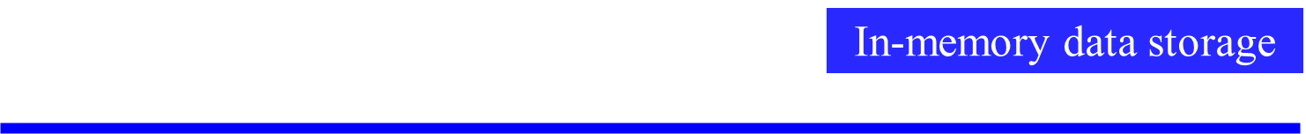
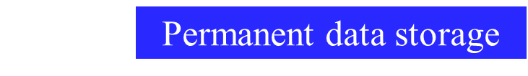
Separation of Concerns in Web Apps
Presentation layer
Data content layer
Data representation layer
Data storage layer
Introduction to Software Testing (Ch 7.2)
© Ammann and Offutt

Slide 50
Differences in Testing Web Software
Traditional graphs do not apply
  Control flow graph
  Call graph
State behavior is hard to model and describe
All inputs go through the HTML UI – low controllability
Hard to get access to server-side state (memory, files, database) – low observability
Not clear what logic predicates can be effectively used
No model for mutation operators on web software
Introduction to Software Testing (Ch 7.2)
© Ammann and Offutt

Slide 51
New Essential Problems of Web Apps
Web site applications feature distributed integration and are extremely loosely coupled
  Internet and diverse hardware / software
HTML forms are created dynamically by web applications
  UI created on demand and can vary by user and time
Users can change the flow of control arbitrarily
  back button, forward button, URL rewriting, refresh
Dynamic integration of new software components
  new components can be added during execution
Introduction to Software Testing (Ch 7.2)
© Ammann and Offutt

Slide 52
Problem 1: Loosely Coupled
server
server
server
client
server
Traditional software
Connected by calls and message passing
High and moderate coupling
Web-based software
Connected with HTTP and XML
Loose, extremely loose, distributed coupling
How can we ensure the reliability of this type of software?
Introduction to Software Testing (Ch 7.2)
© Ammann and Offutt

Slide 53
Extremely Loose Coupling
Tight Coupling : Dependencies among the methods are encoded in their logic
  Changes in A may require changing logic in B
Loose Coupling : Dependencies among the methods are encoded in the structure and data flows
  Changes in A may require changing data uses in B
Extremely Loose Coupling (ELC) : Dependencies are encoded only in the data contents
  Changes in A only affects the contents of B’s data
Introduction to Software Testing (Ch 7.2)
© Ammann and Offutt

Slide 54
Problem 2: Dynamic Flow of Control
WebPics
How you’ns doin’ Jeff Offutt!
WebPics
Huan ying guang ling, Li Nan!
Search
Search
Recommended Movies
Recommended Movies
X
XX
XXX
A
B
C
D
Examine queue
(Warning: Queue empty)
Examine queue
View account
View account
Frequent customer bonus
How can we ensure the reliability of this type of system?
Introduction to Software Testing (Ch 7.2)
© Ammann and Offutt

Slide 55
Dynamic Execution of Web Apps
Parts of the program are generated dynamically
Dynamic web pages are created when users make requests
Different users will see different programs !
The potential control, ala the traditional control flow graph, cannot be known ahead of time
The potential flow of control cannot be known statically
Introduction to Software Testing (Ch 7.2)
© Ammann and Offutt

Slide 56
Problem 3: User Control Flow
Users can make unexpected changes to the flow of control
  Operational transitions are NOT based on an HTML link or program statement
  Back button, forward button, refreshing, caching, URL rewriting
Web software platforms offer new control flow mechanisms
  Forward, redirect, asynchronous message passing (Ajax)
State is stored in the server and in the HTML in the client’s browser
These transitions can cause unanticipated changes to the state of the web application
How can we ensure the reliability of this type of software?
Introduction to Software Testing (Ch 7.2)
© Ammann and Offutt

Slide 57
Problem 4: Dynamic Integration
Software modules can dynamically integrate with others if they use the same data structures
EJBs can be inserted into web applications, which can immediately start using them
Web services find and bind to other web services dynamically
Introduction to Software Testing (Ch 7.2)
© Ammann and Offutt

Slide 58
Section 7.2 Outline
Overview
Static Hyper Text Web Sites
Dynamic Web Applications
  Client-side testing
  Server-side testing
Testing Web Services
Static Hyper Text Web Sites
Introduction to Software Testing (Ch 7.2)
© Ammann and Offutt

Slide 59
Testing Static Hyper Text Web Sites
This is not program testing, but checking that all the HTML connections are valid
The main issue to test for is dead links
We should also evaluate
  Load testing
  Performance evaluation
  Access control issues
The usual model is that of a graph
  Nodes are web pages
  Edges are HTML links
Introduction to Software Testing (Ch 7.2)
© Ammann and Offutt

Slide 60
Section 7.2 Outline
Overview
Static Hyper Text Web Sites
Dynamic Web Applications
  Client-side testing
  Server-side testing
Testing Web Services
Dynamic Web Applications
Introduction to Software Testing (Ch 7.2)
© Ammann and Offutt

Slide 61
Testing Dynamic Hyper Text Web Sites
The user interface is on the client
Some software is on the client (scripts such as Javascript)
Most software is on the server
Client-side testing does not access source or state on the server
Server-side testing can use the source or the server state
Introduction to Software Testing (Ch 7.2)
© Ammann and Offutt

Slide 62
Section 7.2 Outline
Overview
Testing Static Hyper Text Web Sites
Testing Dynamic Web Applications
  Client-side testing
  Server-side testing
Testing Web Services
Client-side testing
Introduction to Software Testing (Ch 7.2)
© Ammann and Offutt

Slide 63
Client-Side (Black-Box) Testing
The UI and the software are on separate computers
The inputs to web software are defined by the HTML form elements
  Text boxes, buttons, dropdown lists, links, etc
Techniques for generating values
  Supplied by the tester
  Generated randomly
  User session data – data collected from previous users of the software
Choosing values
  Bypass testing – values that violate constraints on the inputs, as defined by client-side information
The problem of finding all screens in a web application is undecidable
Introduction to Software Testing (Ch 7.2)
© Ammann and Offutt

Slide 64
Test Value Selection
Challenge
  How to automatically provide effective test values ?
Semantic Domain Problem (SDP)
  Values within the application domain are needed
  Enumeration of all possible test values is inefficient
Possible solutions
  Random values (ineffective)
  Automatically generated values (very hard!)
  User data (incomplete)
  Study application and construct a set of values (feasible)
  Tester-supplied inputs (feasible but expensive)
Introduction to Software Testing (Ch 7.2)
© Ammann and Offutt

Slide 65


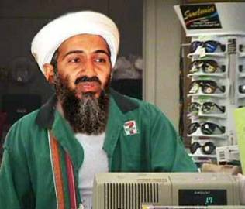


Web Application Input Validation
Bad Data
Corrupts data base
Crashes server
Security violations
Check data
Check data
Sensitive Data
Client
Server
Malicious Data
Can “bypass” data checking
Introduction to Software Testing (Ch 7.2)
© Ammann and Offutt

Slide 66
Bypass Testing
“bypass” client-side constraint enforcement
Bypass testing constructs tests to intentionally violate constraints :
  Eases test automation
  Validates input validation
  Checks robustness
  Evaluates security
Introduction to Software Testing (Ch 7.2)
© Ammann and Offutt

Slide 67
User Name:
Age:
Version to purchase:
Small
$150
Medium
$250
Large
$500
Introduction to Software Testing (Ch 7.2)
© Ammann and Offutt

Slide 68
Invalid data, please correct …
User Name:
Alan<Turing
Age:
500
Username should be plain text only.
Age should be between 18 and 150.
Version to purchase:
Small
$150
Medium
$250
Large
$500
Introduction to Software Testing (Ch 7.2)
© Ammann and Offutt

Slide 69
Abbreviated HTML
<FORM >
<INPUT Type=“text” Name=“username” Size=20>
<INPUT Type=“text” Name=“age” Size=3 Maxlength=3>
<P> Version to purchase:
…
<INPUT Type=“radio” Name=“version” Value=“150” Checked>
<INPUT Type=“radio” Name=“version” Value=“250”>
<INPUT Type=“radio” Name=“version” Value=“500”>
<INPUT Type="submit" onClick="return checkInfo(this.form)">
<INPUT Type=“hidden” isLoggedIn=“no”>
</FORM>
Introduction to Software Testing (Ch 7.2)
© Ammann and Offutt

Slide 70
Bypass Behavior
Extremely loose coupling …
combined with the stateless protocol …
allows users to easily bypass client-side checking :
Users can save and modify the HTML
Introduction to Software Testing (Ch 7.2)
© Ammann and Offutt

Slide 71
Saved & Modified HTML
<FORM >
<INPUT Type=“text” Name=“username” Size=20>
<INPUT Type=“text” Name=“age” Size=3 Maxlength=3>
<P> Version to purchase:
…
<INPUT Type=“radio” Name=“version” Value=“150”>
<INPUT Type=“radio” Name=“version” Value=“250”>
<INPUT Type=“radio” Name=“version” Value=“500” Checked>
<INPUT Type=“submit” onClick=“return checkInfo (this.form)”>
<INPUT Type=“hidden” isLoggedIn= “no” >
</FORM>
Allows an input with arbitrary age, no checking, cost=$25 …
‘<‘ can crash an XML parser
Text fields can have SQL statements
25
yes
Introduction to Software Testing (Ch 7.2)
© Ammann and Offutt

Slide 72
SQL Injection
turing
’ OR ‘1’=‘1
enigma
User Name:
Password:
’ OR ‘1’=‘1
Original SQL:
SELECT username FROM adminuser WHERE username=‘turing’ AND password =‘enigma’
“injected” SQL:
SELECT username FROM adminuser WHERE username=‘turing’ OR ‘1’ = ‘1’ AND password =‘enigma’ OR ‘1’ = ‘1’
Introduction to Software Testing (Ch 7.2)
© Ammann and Offutt

Slide 73
Bypass Testing
This example illustrates how users can “bypass” client-side constraint enforcement
Bypass testing constructs tests to intentionally violate constraints
  Eases test automation
  Checks robustness
  Evaluates security
Preliminary results
  Rules for constructing tests
  Successfully found errors in numerous Web apps
Introduction to Software Testing (Ch 7.2)
© Ammann and Offutt

Slide 74
Applying Bypass Testing
Validating input data on the client is like asking your opponent to hold your shield in a sword fight
Analyze HTML to extract each form element
Model constraints imposed by HTML and JavaScript
Rules for data generation :
  From client-side constraints
  Typical security violations
  Common input mistakes
Introduction to Software Testing (Ch 7.2)
© Ammann and Offutt

Slide 75
Types of Client Input Validation
Client side input validation is performed by HTML form controls, their attributes, and client side scripts that access DOM
Validation types are categorized as HTML and scripting
  HTML supports syntactic validation
  Client scripting can perform both syntactic and semantic validation
HTML Constraints | Scripting Constraints
Length (max input characters) Value (preset values) Transfer Mode (GET or POST) Field Element (preset fields) Target URL (links with values) | Data Type (e.g. integer check) Data Format (e.g. ZIP code format) Data Value (e.g. age value range) Inter-Value (e.g. credit # + exp. date) Invalid Characters (e.g. <,../,&)
Introduction to Software Testing (Ch 7.2)
© Ammann and Offutt

Slide 76
Example Client-Side Constraint Rules
Violate size restrictions on strings
Introduce values not included in static choices
  Radio boxes
  Select (drop-down) lists
Violate hard-coded values
Use values that JavaScripts flag as errors
Change “transfer mode” (get, post, …)
Change destination URLs
Introduction to Software Testing (Ch 7.2)
© Ammann and Offutt

Slide 77
Example Server-Side Constraint Rules
Data type conversion
Data format validation
Inter-field constraint validation
Inter-request data fields (cookies, hidden)
Introduction to Software Testing (Ch 7.2)
© Ammann and Offutt

Slide 78
Example Security Violation Rules
Potential Illegal Character | Symbol
Empty String
Commas | ,
Single and double quotes | ’ or ”
Tag symbols | Tag symbols < and >
Directory paths | .. ../
Strings starting with forward slash | /
Strings starting with a period | .
Ampersands | &
Control character | NIL, newline
Characters with high bit set | 254 and 255
Script symbols | <javascript> or <vbscript>
© Ammann and Offutt
Introduction to Software Testing (Ch 7.2)

Slide 79
Test Value Selection
Challenge:
  How to automatically provide effective test values?
Semantic Domain Problem (SDP)
  Values within the application domain are needed
  Enumeration of all possible test values is inefficient
Possible Solutions
  Random Values (ineffective – lots of junk)
  Automatically generated values (very hard)
  Taking values from session log files (feasible but incomplete)
  Tester input (feasible)
Our tool used an input domain created by parsing the interface and tester input
Introduction to Software Testing (Ch 7.2)
© Ammann and Offutt

Slide 80
Real-World Examples
atutor.ca
Atalker
demo.joomla.or
Poll, Users
phpMyAdmin
Main page,
Set Theme,
SQL Query,
DB Stats
brainbench.com
Submit Request Info, New user
myspace.com
Events & Music Search
nytimes.com
Us-markets
mutex.gmu.edu
Login form
yahoo.com
Notepad, Composer,
Search reminder, Weather Search
barnesandnoble.com
Cart manager,
Book search/results
amazon.com
Item dispatch,
Handle buy
bankofamerica.com
ATM locator, Site search
comcast.com
Service availability
ecost.com
Detail submit,
Shopping cart control
google.com
Froogle, Language tools
pageflakes.com
Registration
wellsfargolife.com
Quote search
Pure black-box testing
means
no source (or permission) needed !
Introduction to Software Testing (Ch 7.2)
© Ammann and Offutt

Slide 81
Output Checking
(V) Valid Responses : invalid inputs are adequately processed by the server
(F) Faults & Failures : invalid inputs that cause abnormal server behavior (typically caught by web server when application fails to handle the error)
(E) Exposure : invalid input is not recognized by the server and abnormal software behavior is exposed to the users
These do not capture whether the valid responses corrupted data on the server
(V1) | Server acknowledges the invalid request and provides an explicit message regarding the violation
(V2) | Server produces a generic error message
(V3) | Server apparently ignores the invalid request and produces an appropriate response
(V4) | Server apparently ignores the request completely
Introduction to Software Testing (Ch 7.2)
© Ammann and Offutt

Slide 82
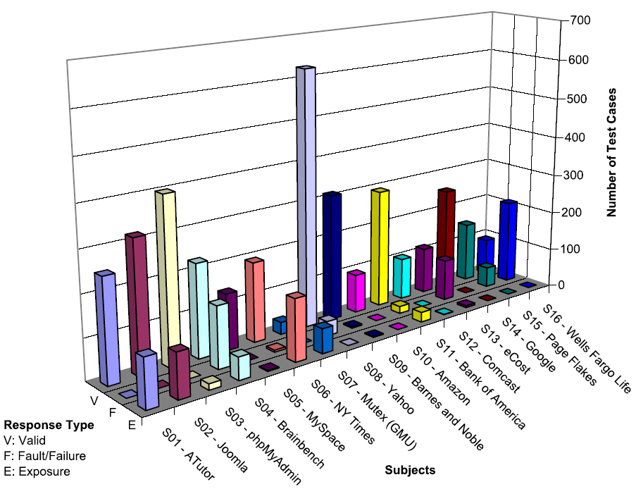
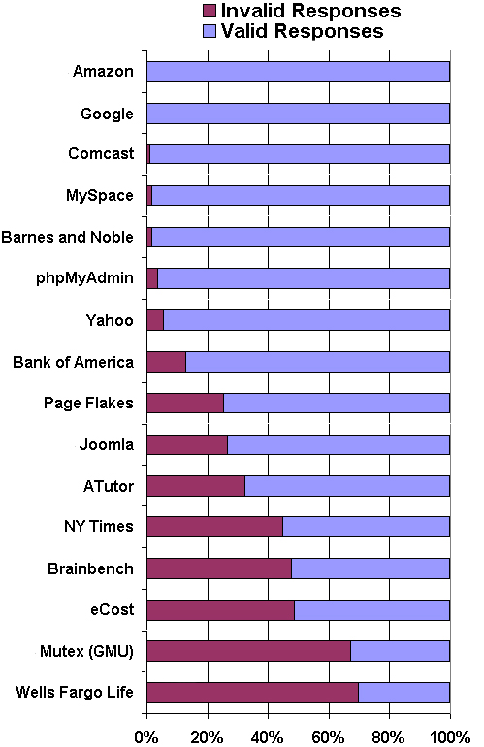
Results
v
Introduction to Software Testing (Ch 7.2)
© Ammann and Offutt

Slide 83
Section 7.2 Outline
Overview
Testing Static Hyper Text Web Sites
Testing Dynamic Web Applications
  Client-side testing
  Server-side testing
Testing Web Services
Server-side testing
Introduction to Software Testing (Ch 7.2)
© Ammann and Offutt

Slide 84
Server-Side (White-Box) Testing
If we have access to the source on the server, we can try to model the web software
Many testing criteria on non-web software rely on a static control flow graph
  Edge testing, data flow, logic coverage, …
  Also slicing, change impact analysis, …
The standard control flow graph cannot be computed for web applications !
But all the pieces of the web pages and the programs are contained in the software presentation layer …
Introduction to Software Testing (Ch 7.2)
© Ammann and Offutt

Slide 85
Atomic Sections :
HTML with static structure and content variables
PrintWriter out = response.getWriter();
P1 =
out.println ("<HTML>")
out.println ("<HEAD><TITLE>" + title + "</TITLE></HEAD>)"
out.println ("<BODY>")
title
if (isUser) {
Atomic
sections
P2 =
out.println (“ <CENTER> Welcome!</CENTER>");
for (int i=0; i<myVector.size(); i++)
if (myVector.elementAt(i).size > 10)
P3 =
out.println (“<p><b>" + myVector.elementAt(i) + "</b></p>");
myVector.elementAt(i)
else
P4 =
out.println (“<p>" + myVector.elementAt(i) + "</p>");
myVector.elementAt(i)
Empty
atomic
section
} else
P5 =
{ }
Content
variables
P6 =
out.println (“</BODY></HTML>");
out.close ();
Introduction to Software Testing (Ch 7.2)
© Ammann and Offutt

Slide 86
Atomic Sections
A section of HTML with the property that if any part of the section is sent to a client, the entire section is
  May include JavaScript
  All or nothing property
An HTML file is an atomic section
Content variable : A program variable that provides data to an atomic section
Atomic sections may be empty
Introduction to Software Testing (Ch 7.2)
© Ammann and Offutt

Slide 87
Modeling Web Applications
Restricted to the presentation layer only
Two levels of abstraction
  Component Interaction Model (CIM)
    Models individual components
    Combines atomic sections
    Intra-component
  Application Transition Graph (ATG)
    Each node is one CIM
    Edges are transitions among CIMs
    Inter-component
Introduction to Software Testing (Ch 7.2)
© Ammann and Offutt

Slide 88
Component Expressions
Atomic sections are combined to model dynamically generated web pages
Four ways to combine:
  Sequence : p1 • p2
  Selection : (p1 | p2)
  Iteration : p1*
  Aggregation : p1 {p2}
    p2 is included inside of p1
The previous example produces:
  p → p1 • (p2 • (p3 | p4)* | p5) • p6
Composite sections can be produced automatically
Introduction to Software Testing (Ch 7.2)
© Ammann and Offutt

Slide 89
Modeling Component Transitions
Five types of transitions
  Simple Link Transition : An HTML link (<A> tag)
  Form Link Transition : Form submission link
  Component Expression Transition : Execution of a software component causes a component expression to be sent to the client
  Operational Transition : A transition out of the software’s control
    Back button, Forward button, Refresh button, User edits the URL, Browser reloads from cache
  Redirect Transition : Server side transition, invisible to user
Introduction to Software Testing (Ch 7.2)
© Ammann and Offutt

Slide 90
Component Interaction Model : gradeServlet
ID = request.getParameter ("Id");
passWord = request.getParameter ("Password");
retry = request.getParameter ("Retry");
PrintWriter out = response.getWriter();
P1 =
out.println (“<HTML> <HEAD><TITLE>" + title + "</TITLE></HEAD><BODY>)"
if ((Validate (ID, passWord)) {
P2 =
out.println (“ <B> Grade Report </B>");
for (int I=0; I < numberOfCourse; I++)
P3 =
out.println(“<p><b>" + courseName (I) + "</b>“ + courseGrade (I) + “</p>”);
} else if (retry < 3) {
P4 =
retry++;
out.println ("Wrong ID or wrong password");
out.println ("<FORM Method=\“get\" Action=\"gradeServlet\">);
out.println ("<INPUT Type=\“text\" Name=\"Id\" Size=10>");
out.println ("<INPUT Type=\“password\" Name=\"Password\" Width=20>");
out.println ("<INPUT Type=\“hidden\" Name=\"Retry\" Value=" + (retry) + ">");
out.println ("<INPUT Type=\“submit\" Name=\“Submit\" Value=\“submit\">");
out.println ("<A Href=\"sendMail\">Send mail to the professor</A>");
} else if (retry >= 3) {
P5 =
out.println (“<p>Wrong ID or password, retry limit reached. Good bye.") }
P6 =
out.println(“</BODY></HTML>");
Introduction to Software Testing (Ch 7.2)
© Ammann and Offutt

Slide 91
CIM for gradeServlet
S = login.html
A = {p₁, p₂, p₃, p₄, p₅, p₆ }
CE = gradeServlet = p₁ • ((p₂ • p₃* ) | p₄ | p₅) • p₆
T = {login.html gradeServlet [get, (Id, Password, Retry)],
gradeServlet.p₄ sendMail [get, ()],
gradeServlet.p₄ gradeServlet [get, (Retry)] }
Introduction to Software Testing (Ch 7.2)
© Ammann and Offutt

Slide 92
Application Transition Graph
Γ : Finite set of web components
Θ : Set of transitions among web software components
  Includes type of HTTP request and data
Σ : Set of variables that define the web application state
α : Set of start pages
Introduction to Software Testing (Ch 7.2)
© Ammann and Offutt

Slide 93
ATG for gradeServlet
Γ = { login.html, gradeServlet, sendMail, syllabus.html }
Θ = {login.html syllabus.html [get, ()],
login.html gradeServlet [get, (Id, Password, Retry)],
gradeServlet.p₄ sendMail [get, ()],
gradeServlet.p₄ gradeServlet [get, (Retry)] }
Σ = { Id, Password, Retry }
α = { login.html }
Introduction to Software Testing (Ch 7.2)
© Ammann and Offutt

Slide 94
ATG for gradeServlet
get ()
login.html
get ()
syllabus.html
get
(Id, Password, Retry)
get (Id, Password, Retry)
gradeServlet
p1
p2
p4
p5
get ()
sendMail
p3
p6
Introduction to Software Testing (Ch 7.2)
© Ammann and Offutt

Slide 95
Atomic Section Modeling
Atomic sections provide a fundamental mechanism to model Web applications presentation layer
Can handle :
  Distributed integration
  Dynamically created HTML pages
  Operational transitions
Requires deep analysis of software source
Introduction to Software Testing (Ch 7.2)
© Ammann and Offutt

Slide 96
Some Current Open Questions
How to define data flow?
  DU-pairs cannot be determined statically – uses cannot always be found
Automatically generating ATG
Issues not handled:
  Session data
  Multiple users
  Concurrency
  Input data
  Output validation
  Dynamic integration
Introduction to Software Testing (Ch 7.2)
© Ammann and Offutt

Slide 97
Section 7.2 Outline
Overview
Static Hyper Text Web Sites
Dynamic Web Applications
  Client-side testing
  Server-side testing
Testing Web Services
Testing Web Services
Introduction to Software Testing (Ch 7.2)
© Ammann and Offutt

Slide 98
Web Services
A Web Service is a program that offers services over the Internet to other software programs
  Internet-based
  Uses SOAP and XML
  Peer-to-peer communication
Web service components can integrate dynamically, by finding other services during execution
Web services transmit data that are formatted in XML
Introduction to Software Testing (Ch 7.2)
© Ammann and Offutt

Slide 99
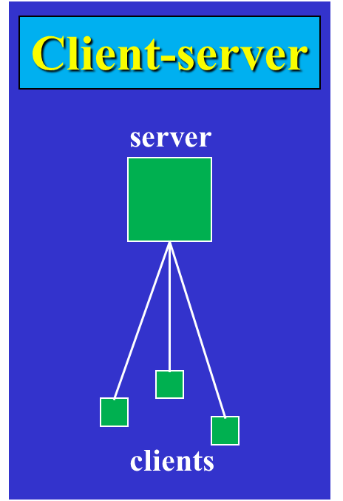
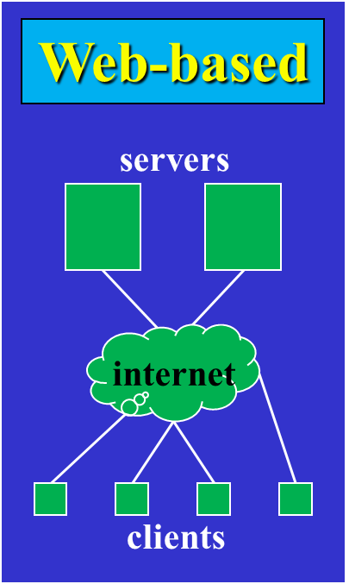
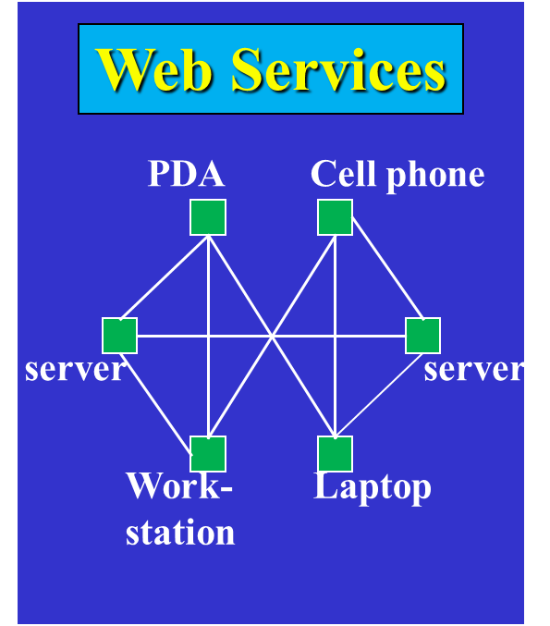
Web Service Architecture
Introduction to Software Testing (Ch 7.2)
© Ammann and Offutt

Slide 100
Web Service Technologies
Find
UDDI Registry
WSDL Specification
Applications
SOAP / XML
Points to URL
SOAP / XML
Specification
Specification
Bind
Publish
Wrapped
Wrapped
Legacy System
Components
Services
Introduction to Software Testing (Ch 7.2)
© Ammann and Offutt

Slide 101
Difficulties of Testing Web Services
Web services are always distributed
Most “peer-to-peer” communication is between services published by different organizations
  Trust is a major issue holding back the adoption of web services !
Design and implementation are almost never available
Structured messages are transmitted
Most testing research so far has focused on messages
  Syntax-based test criteria have been proposed for Web services
Introduction to Software Testing (Ch 7.2)
© Ammann and Offutt

Slide 102
Conclusions
The Web provides a new way to deploy software
Web applications:
  offer many advantages
  use many new technologies
  introduce fascinating new problems
Web Software Engineering is just beginning
Two very useful techniques:
  Bypass testing : Easy to automate – no source needed
  Atomic sections : A fundamental model
This is a very active research area
Introduction to Software Testing (Ch 7.2)
© Ammann and Offutt

